Slide 1

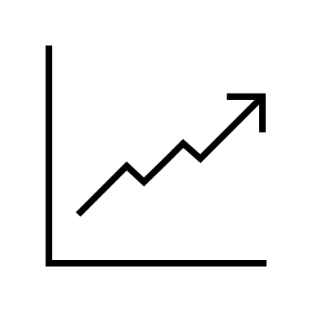
IS6400:
Business Data Analytics
Time Series I: Smoothing

Slide 2
Delivery mode adjustment
A set of slides will be in companion with the Jupyter notebooks.
https://github.com/zhiyzuo/IS6400-Regression
As before, you could simply run the notebook but no need to change code for the purpose of this course.
We will discuss the code line by line in tutorial.

Slide 3
Your feedback is always appreciated
Please do not hesitate to contact me if you have any confusion.
My regular OH: 10am to 11:45am on Wednesdays
https://cityu.zoom.us/j/99754454964?pwd=dzVMb1kvS3VTd2UvVTgzMzh0N3hrUT09
But we can set up other times.

Slide 4
Week 6 Makeup
A make-up lecture for Week 6 materials will be made on March 5th from 2pm to 5pm.
The idea is for me to record the lecture and tutorial via a new presentation approach. But if any of you are interested, please join me. Recordings will be made public.
https://cityu.zoom.us/j/95851096414?pwd=WGU3T04vY3crTlZWc1A3MVQ5V0txUT09

Slide 5
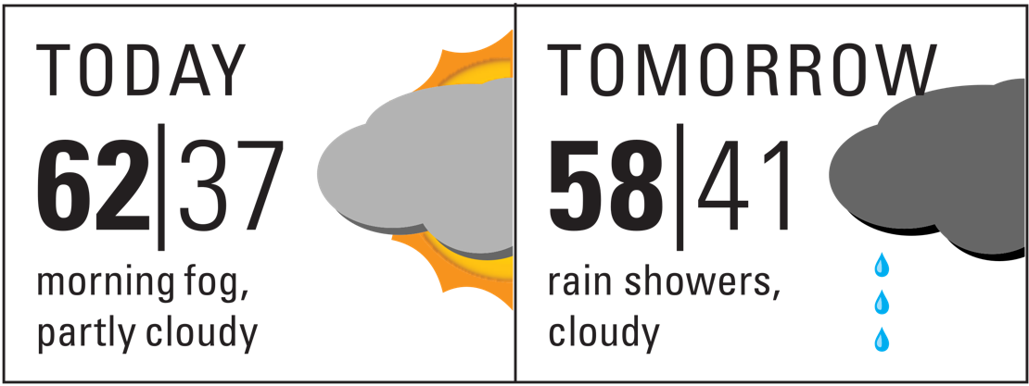

Forecasting
Notes:
In the business context, forecasting is commonly adopted across various scenarios.
In finance, one usually find it important to make use of forecasting tools to help predict the future stock or cryptocurrency values to make profits.
In operations management, it is critical to accurately manage inventory to avoid excessive storage cost due to misprediction of demand from the customers.

Slide 6

Forecasting via Judgement
Notes:
One is qualitative approach, which is often referred to as judgemental forecasts
involving mental calculation using information which may be partially available or biased.
judgemental forecasts are highly subjective and may vary across individuals due to limits in both internal factors (e.g., cognitive limits)
as well as external ones (e.g., political agendas).

Slide 7
Why go this route?
Little or limited access to data
Important to include domain knowledge
Example:
Forecasting a new product…
Estimating the listed price for an apartment

Slide 8

Australian Cigarette Package

Slide 9
Judgmental Forecasts
One common approach: Delphi approach
Expert panel formation
Task distribution to panel
Forecast on proposed analogy
Assess similarity with target situation
Final forecast by weighted average
Notes:
Iterative discussion such as interviewing and surveying

Slide 10

Quantitative approach: Our Focus
When there’s data!
Notes:
. To a large extent, extant data, especially well structured data, can provide significant amounts of signals to complement our qualitative assessment for a better prediction.

Slide 11
What we will talk about
Time series features
Exponential Smoothing
AutoRegresison
Week 7
Week 8

Slide 12
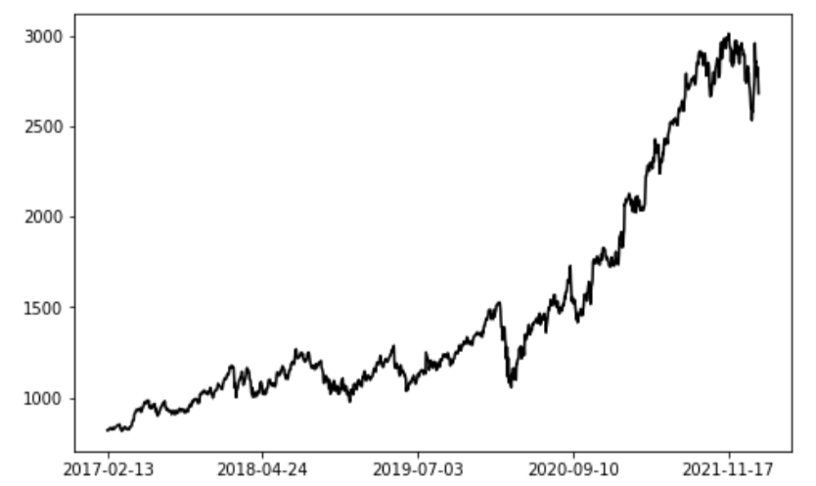
Our journey begins with…
What is time series data?

Slide 13
Different types of data
Cross-sectional: Records about different objects (collected at the same time)
Example?
Student grade from IS6400 in 21/22 SemB
Features of hotels on Airbnb in Jan 2022
…

Slide 14
Different types of data
Time Series: repetitive data collected from the same object over time
Example?
Xiaomi’s stock price over time
Hilton Garden Inn’s ratings over time

Slide 15
Different types of data
Panel: Time series + Cross-sectional
Multiple objects
Multiple data collection time
Examples?
Airbnb rooms features from 2018 to 2022
S&P500 firms’ financial indicators from 2018 to 2022

Slide 16
We focus on time series
Google Price data from 2017 to 2021

Slide 17
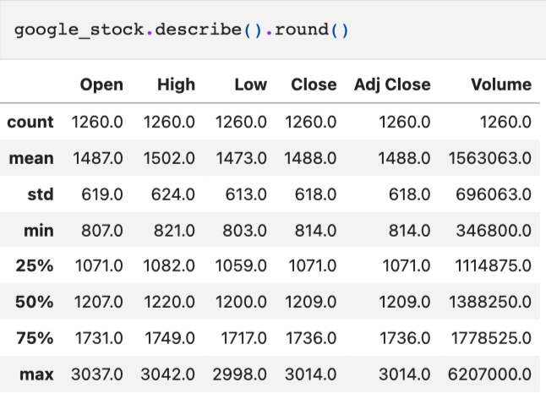
Where we start?
First step: no rush into any models!
Know your data!
Notes:
First look at the data.
e.g., outlier? Missing values?

Slide 18
Autocorrelation
Recall what is correlation?
Correlation in time series: autocorrelation
Correlation with the time series itself
Between lagged values!
Notes:
Linear relationship between two variables.

Slide 19
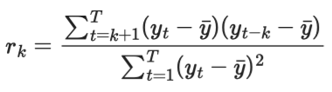
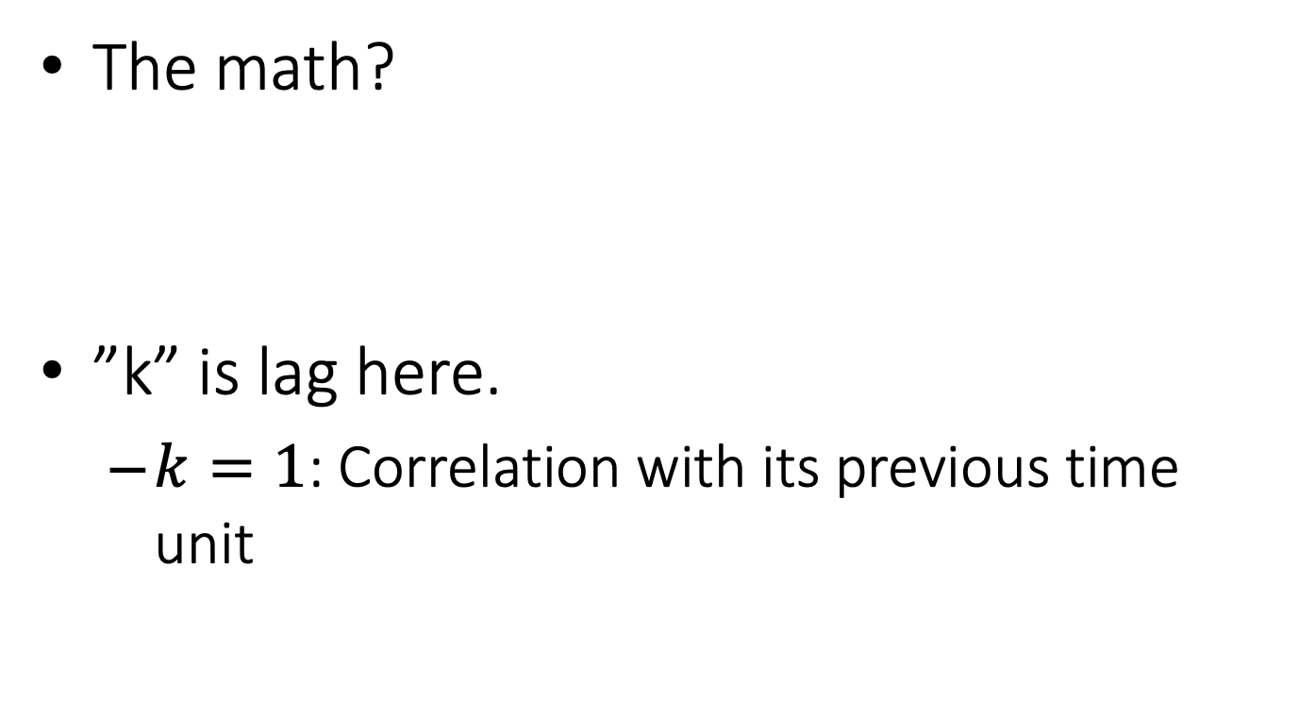
Autocorrelation
The math?
”k” is lag here.
$k=1$: Correlation with its previous time unit

Slide 20
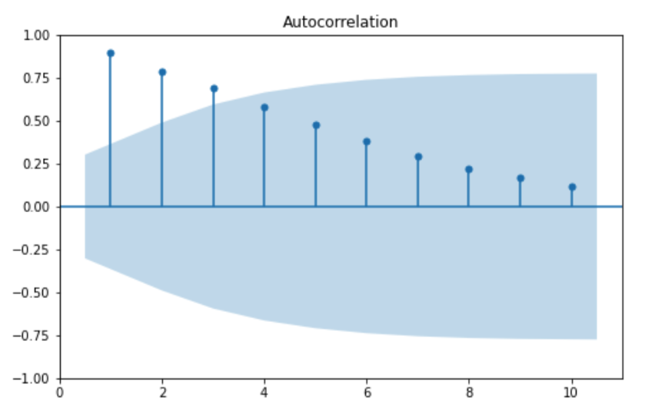
Autocorrelation in action
Significant corr.
Insignificant corr.
Notes:
Monthly closing price.
Shade: confidence interval
Line: the correlation value

Slide 21
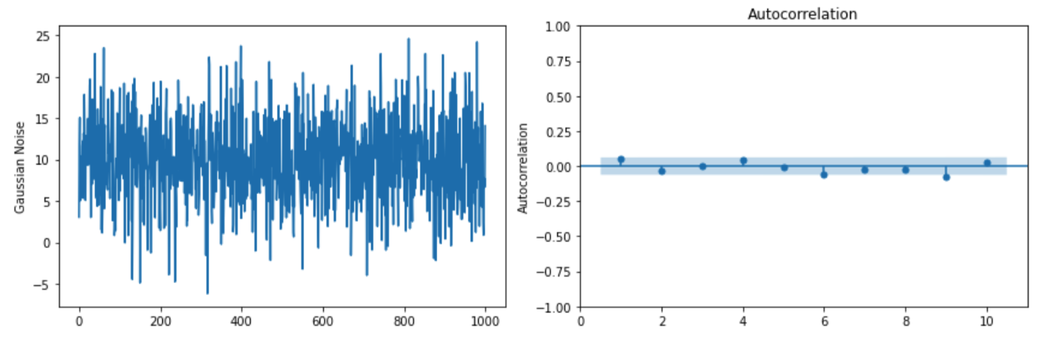
White noise: no autocorrelation
None is significant

Slide 22
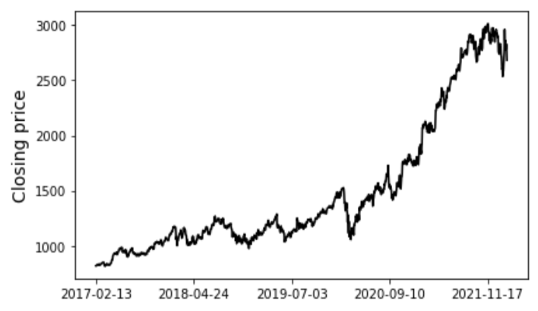
Stationarity
A time series in non-stationary if there are any patterns of trend or seasonality.
Any pattern here?
Notes:
whether the statistical charateristics of a time series depends on the observation time of its values

Slide 23
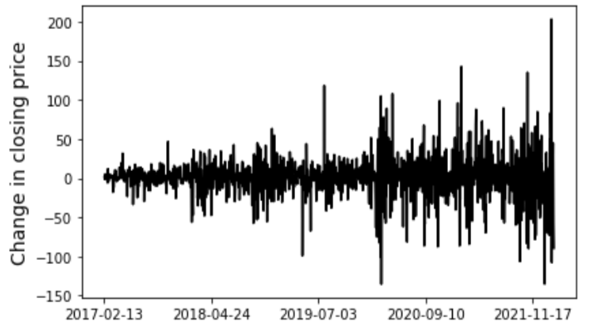
Stationarity
A time series is non-stationary if there are any patterns of trend or seasonality.
How about this one?
Notes:
whether the statistical charateristics of a time series depends on the observation time of its values
We may turn a non-stationary time series data into a stationary one by differecing

Slide 24
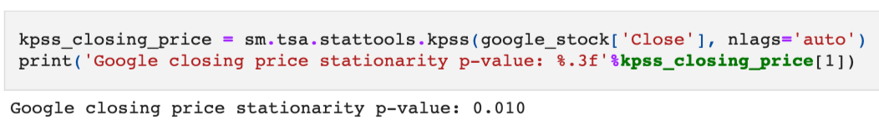
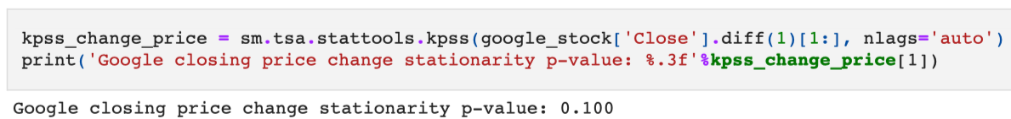
Stationarity: Statistical test
We may also quantitively tell whether one is stationary or not.
Kwiatkowski-Phillips-Schmidt-Shin (KPSS) test
Null hypothesis: A time series is stationary
Notes:
In Python: we can use the statsmodels API to do the test

Slide 25
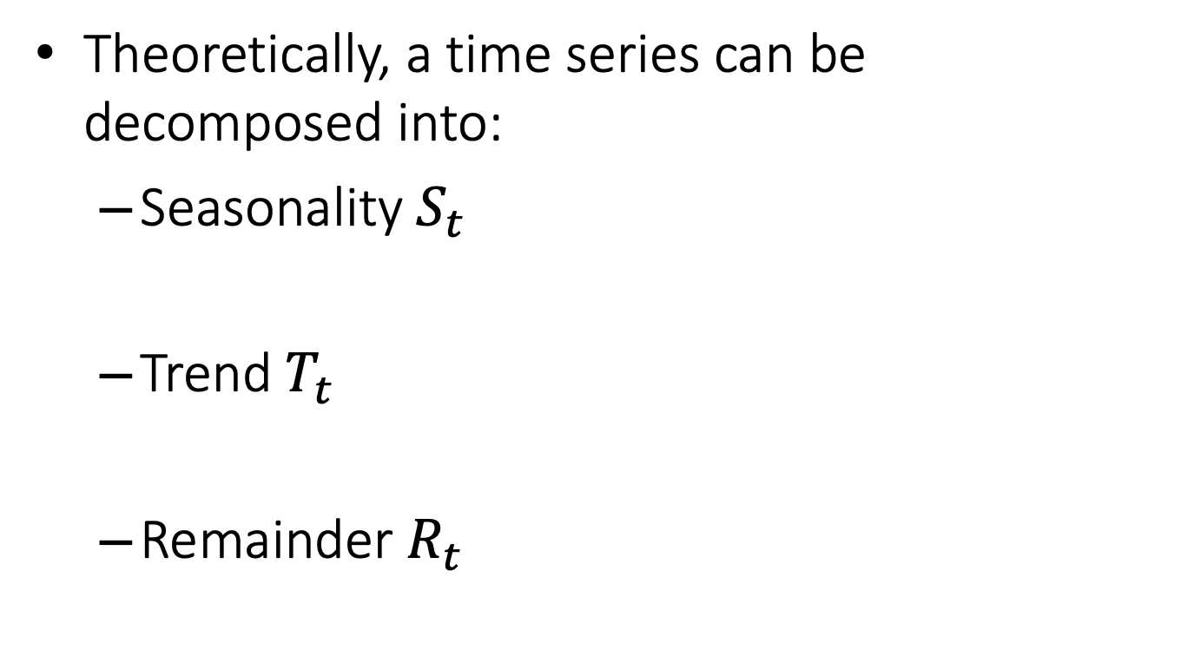
What makes a pattern?
Theoretically, a time series can be decomposed into:
Seasonality $S_{t}$
Trend $T_{t}$
Remainder $R_{t}$
Stationarity or not?
Noise and uncaptured pattern
Notes:
Seasonality: monthly (12) quarterly (4) weekly (52)
remainder is not just the error but also pattern not captured

Slide 26
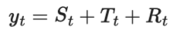
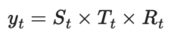
Additive vs. Multiplicative
Additive: When trend/seasonality is constant over time
Multiplicative: varying trend/seasonality

Slide 27
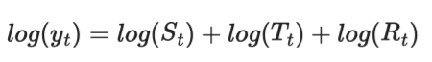
STL decomposition
One popular approach but additive only
Are additive and multiplicative mutually exclusive?
S: Seasonality
T: Trend
L: using LOESS (local regression)

Slide 28
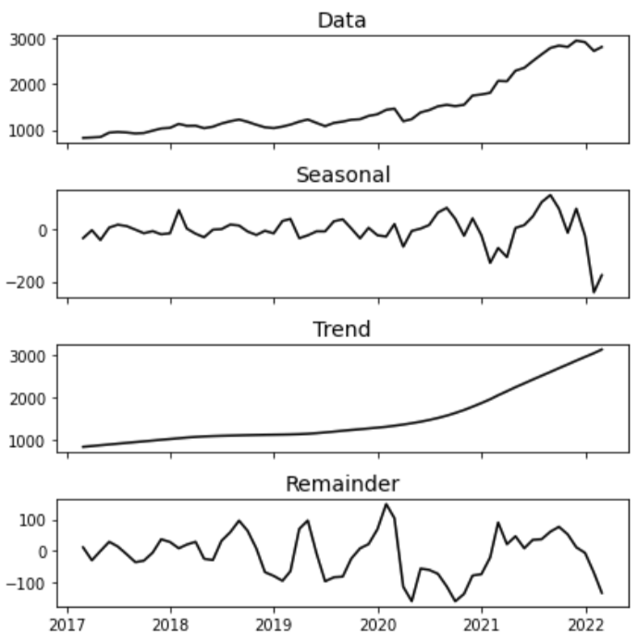
STL decomposition: Example

Slide 29
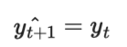
Alright, now we talk about forecasting.
What’s the approach that comes to your mind if you:
Have historical data from time 1 to T;
Want to predict data at time T+1?
Simple but…
Notes:
Usually known as the naive forecast method.
What’s the issue?

Slide 30
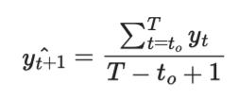
The simple approach
We could make use of the one-step before value for the next one
But maybe the reliance on just one point is inaccurate.
Hey! Let’s add more:
But still…
Notes:
The recent few data points
Equally weighted?

Slide 31

Now enter simple exp. smoothing
Intuitively, the pattern which is further away is less important in the forecast
Let’s make more recent points more important:
Why $α$ only? Because it’s simple to infer…
Notes:
Why not make arbitrary parameters?
We will see this in the AR model.

Slide 32
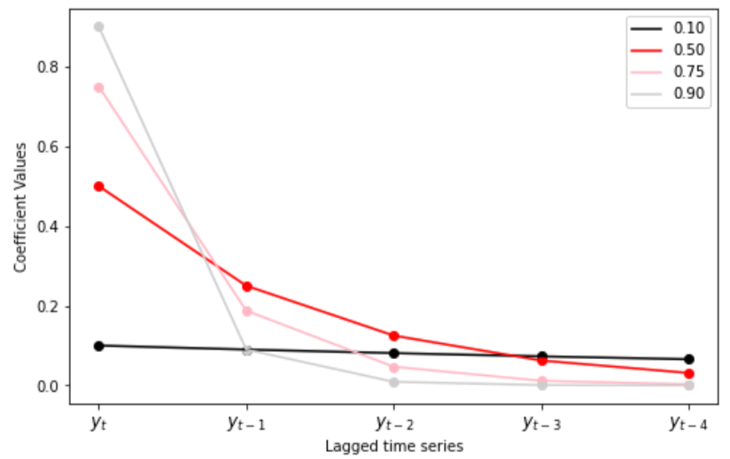

The role of $α$
The bigger it is, the less important
of the past data
Notes:
Smaller: more equally weighted

Slide 33
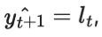
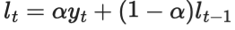
The component form of this model
Forecast equation:
Smoothing (level) equation:
Notes:
weighted average

Slide 34
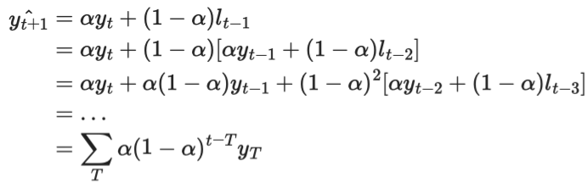
Math behind it (Optional)

Slide 35
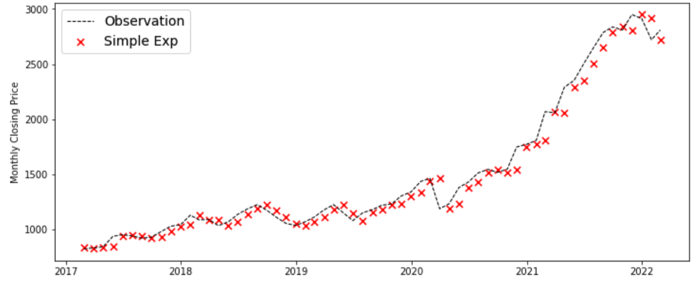
Simple Exp. Smoothing: Example
We’re only fitting the model though AND
one-step ahead prediction only.
Notes:
This is just fitting!

Slide 36
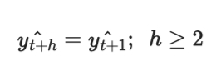
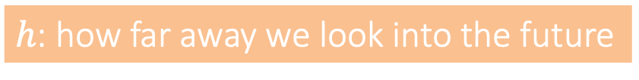
What’s the issue?
Flat prediction:
Solution: capturing the trend!
$h$: how far away we look into the future

Slide 37
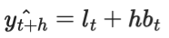
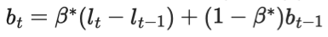
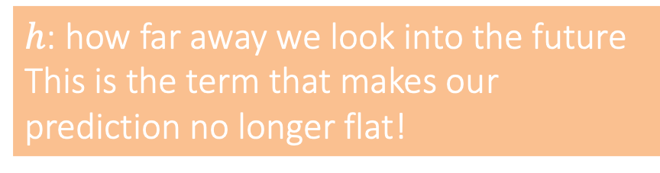
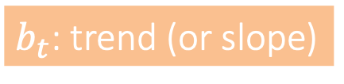
Holt’s Method
We need more stuff to train the model now:
Forecast
Smoothing
Trend
$h$: how far away we look into the future
This is the term that makes our prediction no longer flat!
$b_{t}$: trend (or slope)

Slide 38
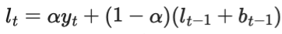
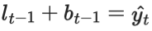
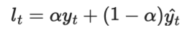
Mechanism behind Holt’s Method
Isn’t it the same as what we have before?

Slide 39
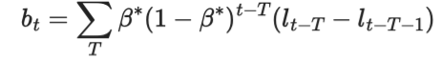
Mechanism behind Holt’s Method
Isn’t this familiar to us?
Notes:
The exponential smoothing for trend (slope b)

Slide 40
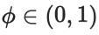
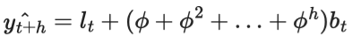
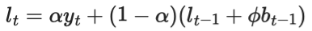
Constant or Changing Trend?
Does trend last forever without changing at all?
Damping parameter
Forecast
Smoothing
Trend
Trend effect is weakened over time

Slide 41
Recall that there are two components
We have trend now. What’s next?
Seasonality!
Sales of certain products may exhibit seasonal patterns
Temperature may also feature seasonal dynamics

Slide 42
Holt-Winter’s (or Winter’s) Method
As with the decomposition, there are two forms of Winter’s method as well
Additive vs. Multiplicative
For simplicity, we talk more details about additive but skip multiplicative.
In using Python, it is easy to change from one to the other.

Slide 43
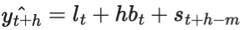
Winter’s Method: Additive
Forecast
Smoothing
Trend
Seasonality

Slide 44
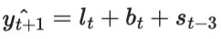
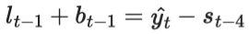

Example: quarterly data $m=4$
The most recent and same season

Slide 45
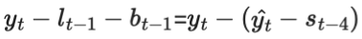
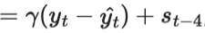
Example: quarterly data $m=4$
Last seasonality plus weighted forecast error

Slide 46
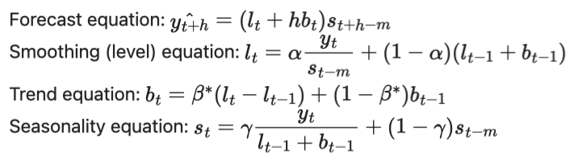
Multiplicative counterpart (optional)
See the notebook:
Notes:
Here, the trend is modelled as additive while the seasonality as multiplicative.

Slide 47
Forecasting evaluation
What does it make a good prediction?
Does cross validation work?

Slide 48
Data partitioning: Order Matters!
Fixed partitioning
Roll forward
1
2
3
4
5
6
1
2
3
4
5
6

Slide 49
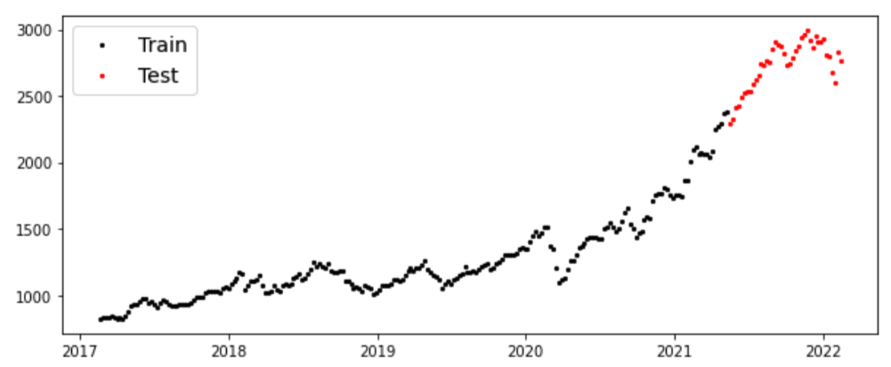
Fixed partitioning
One-time split with:
Training set as the history
Testing set as the future

Slide 50
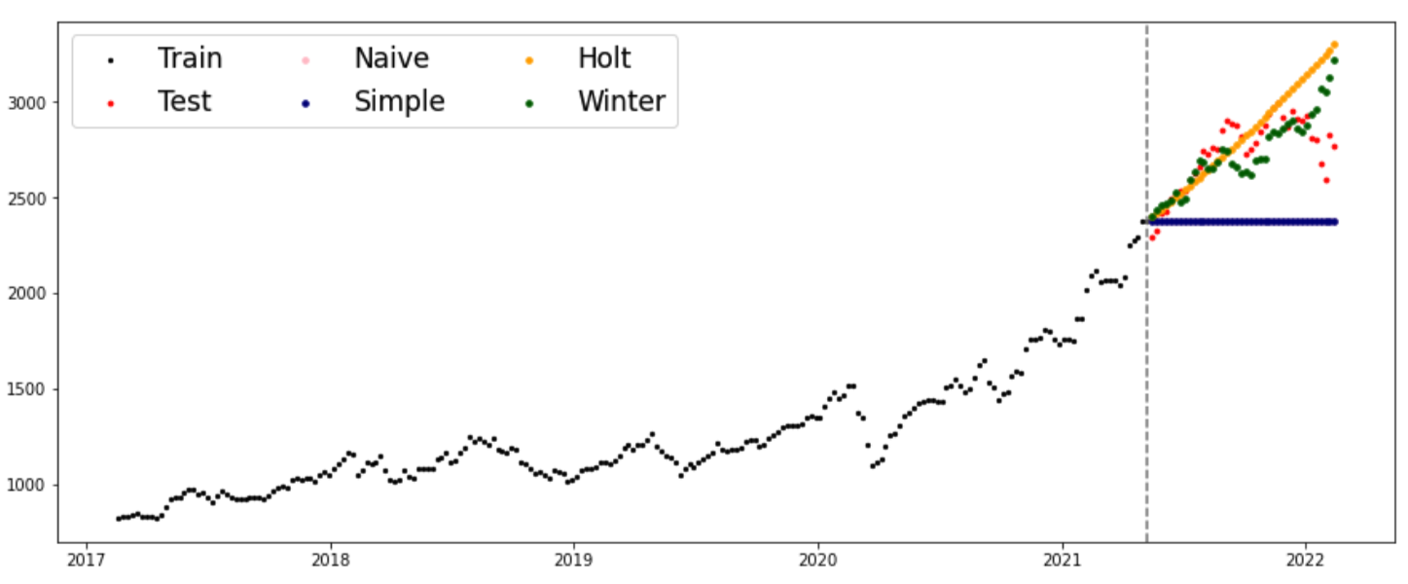
Example

Slide 51
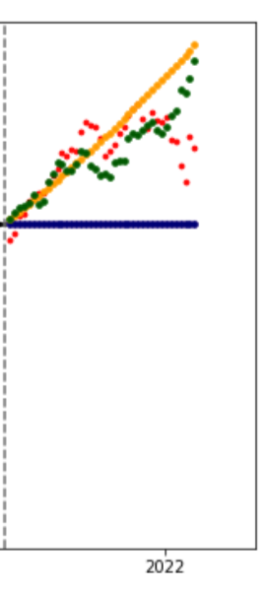
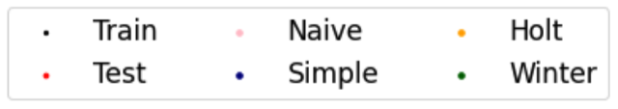
Example
See the flat prediction here?

Slide 52
Roll forward
The time- series version of cross validation
Iteratively shift the time series splitting for training and testing
1
2
3
4
5
6

Slide 53
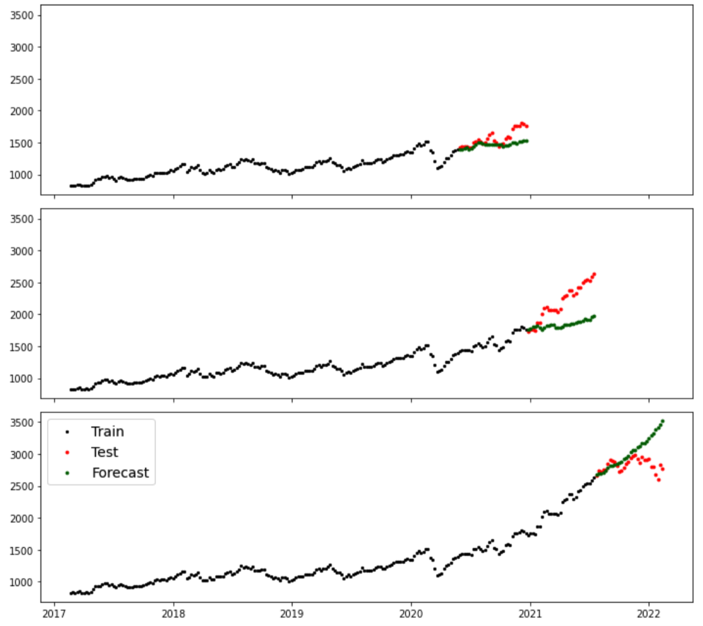
Example
Forecast made by Winter’s method.

Slide 54
A summary
Time series features/characteristics
Forecasts via exponential smoothing
What time series components are we thinking about?

Slide 55
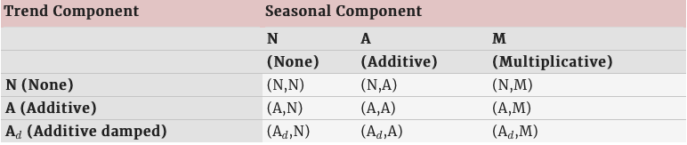
A summary of smoothing
From Table 8.5 of Hyndman and Athanasopoulos (2018)

Slide 56
Suggested References
Hyndman, R.J., & Athanasopoulos, G. (2021) Forecasting: principles and practice, 3rd edition, OTexts: Melbourne, Australia. OTexts.com/fpp3.
Business analytics using forecasting: https://youtube.com/playlist?list=PLoK4oIB1jeK0LHLbZW3DTT05e4srDYxFq

Slide 57

The End

